Slide 1


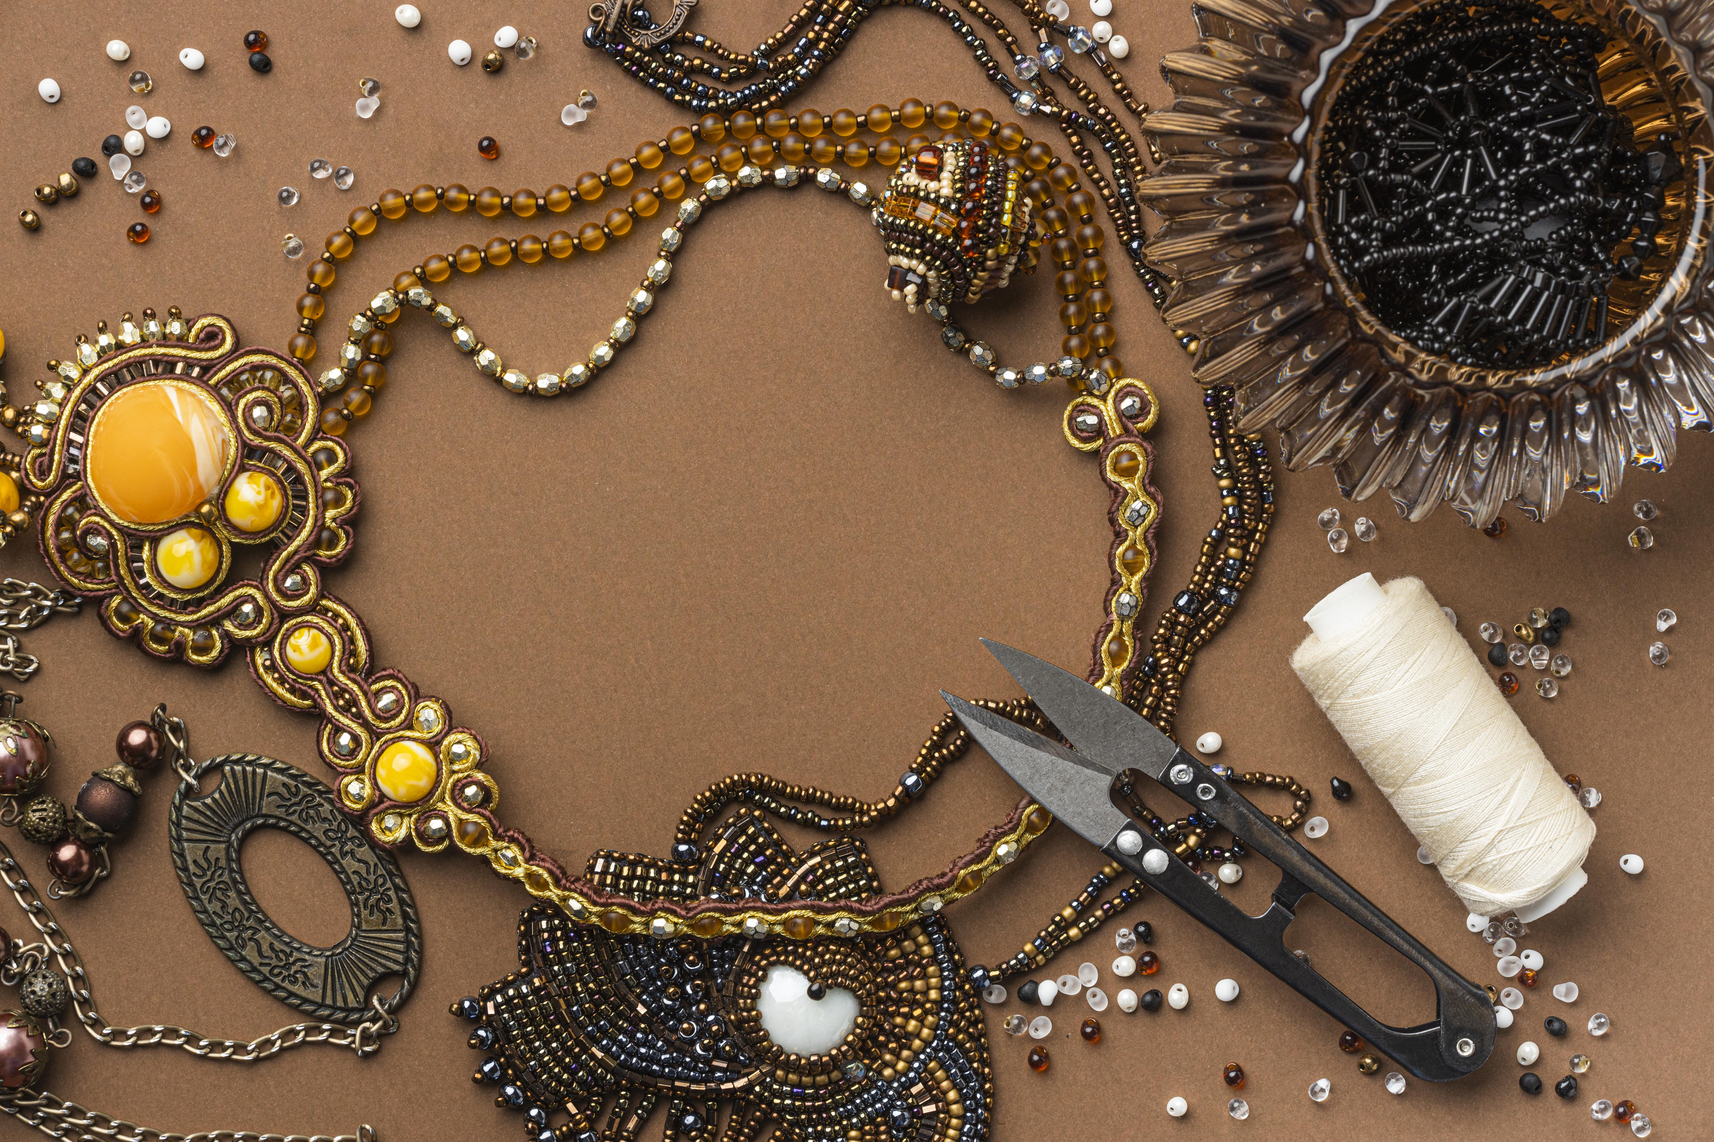
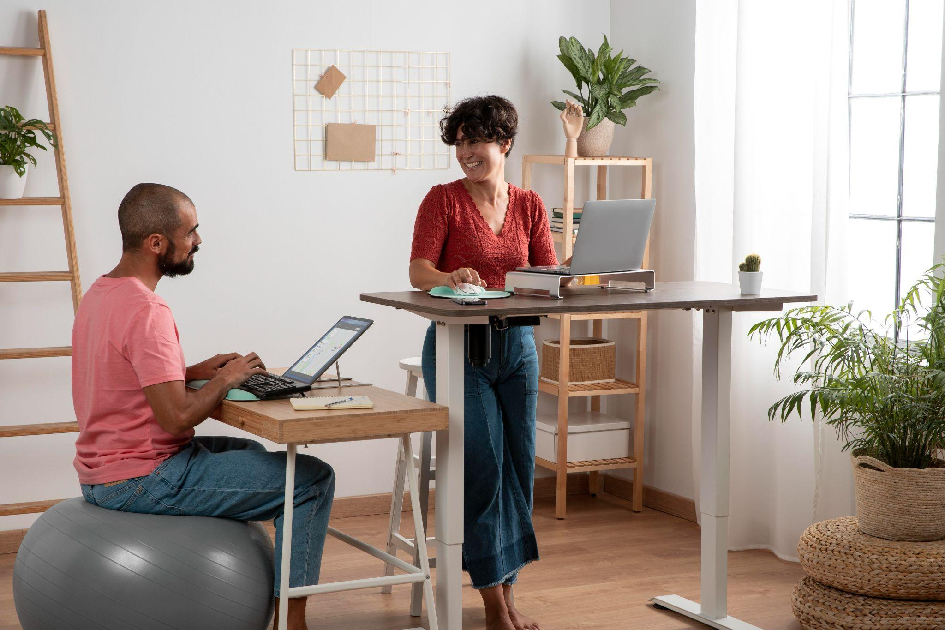
Marketing strategy

Slide 2

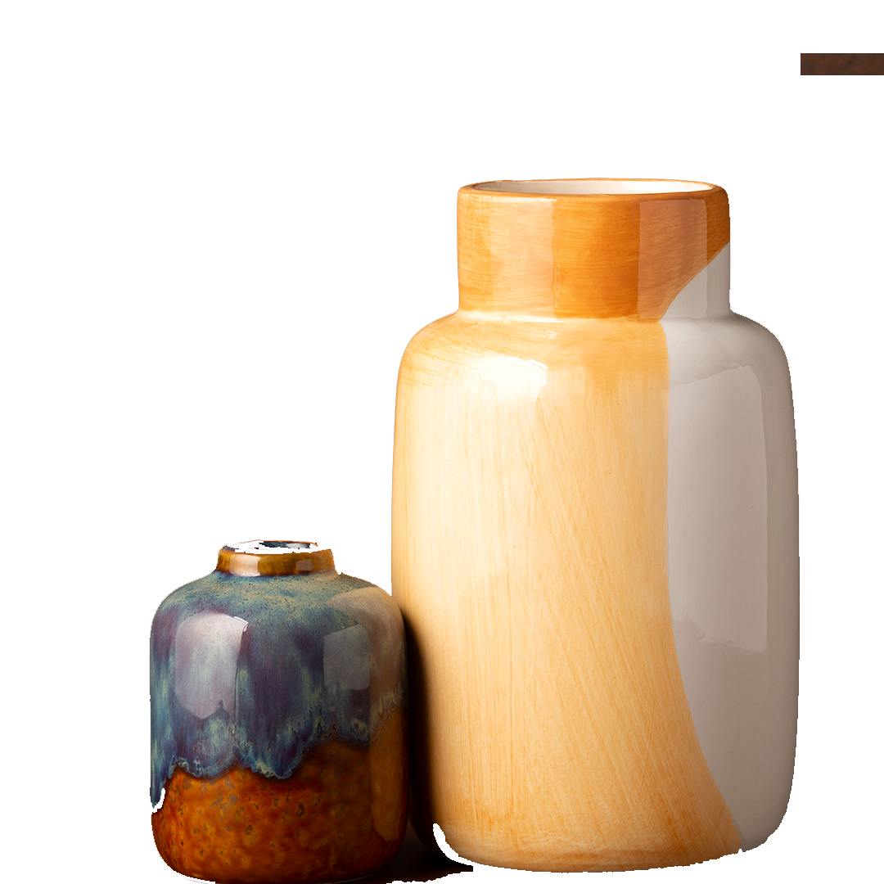
Table of contents
01
02
03
04
05
06
BUSINESS MODEL CANVAS
OBJECTIVES
MARKET ANALYSIS
CUSTOMER PERSONA
CHANNELS
BRAND VOICE
07
CONTENT CALENDAR

Slide 3
Table of contents
08
09
10
11
12
13
E MAIL MARKETING
KEYWORDS
WEBSITE
PAID ADS
KPIs
BUDGET
14
THANK YOU

Slide 4
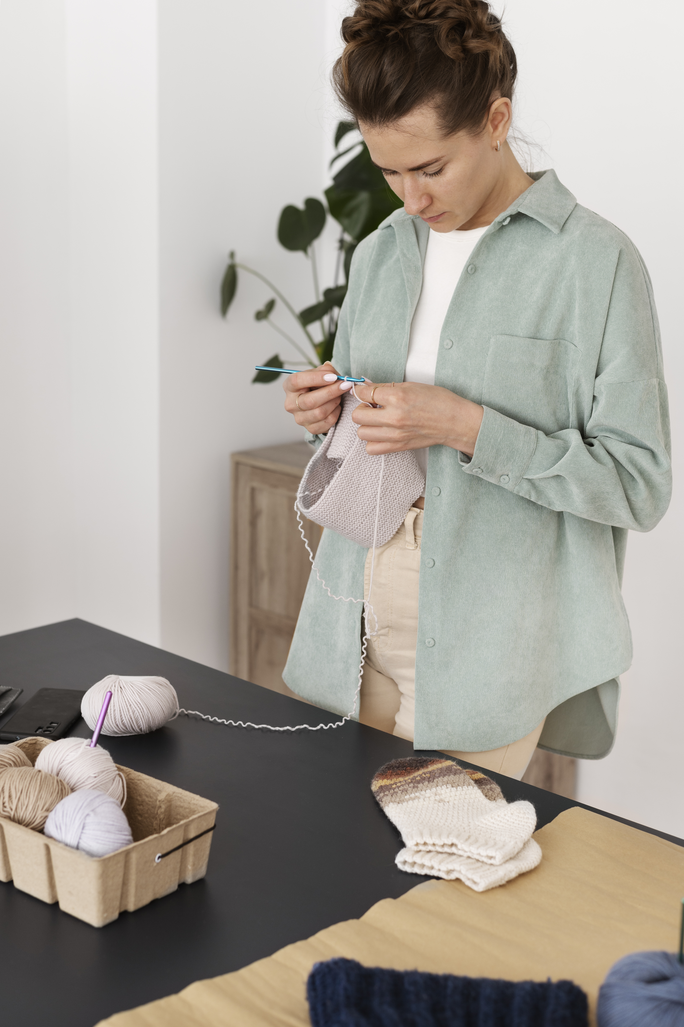
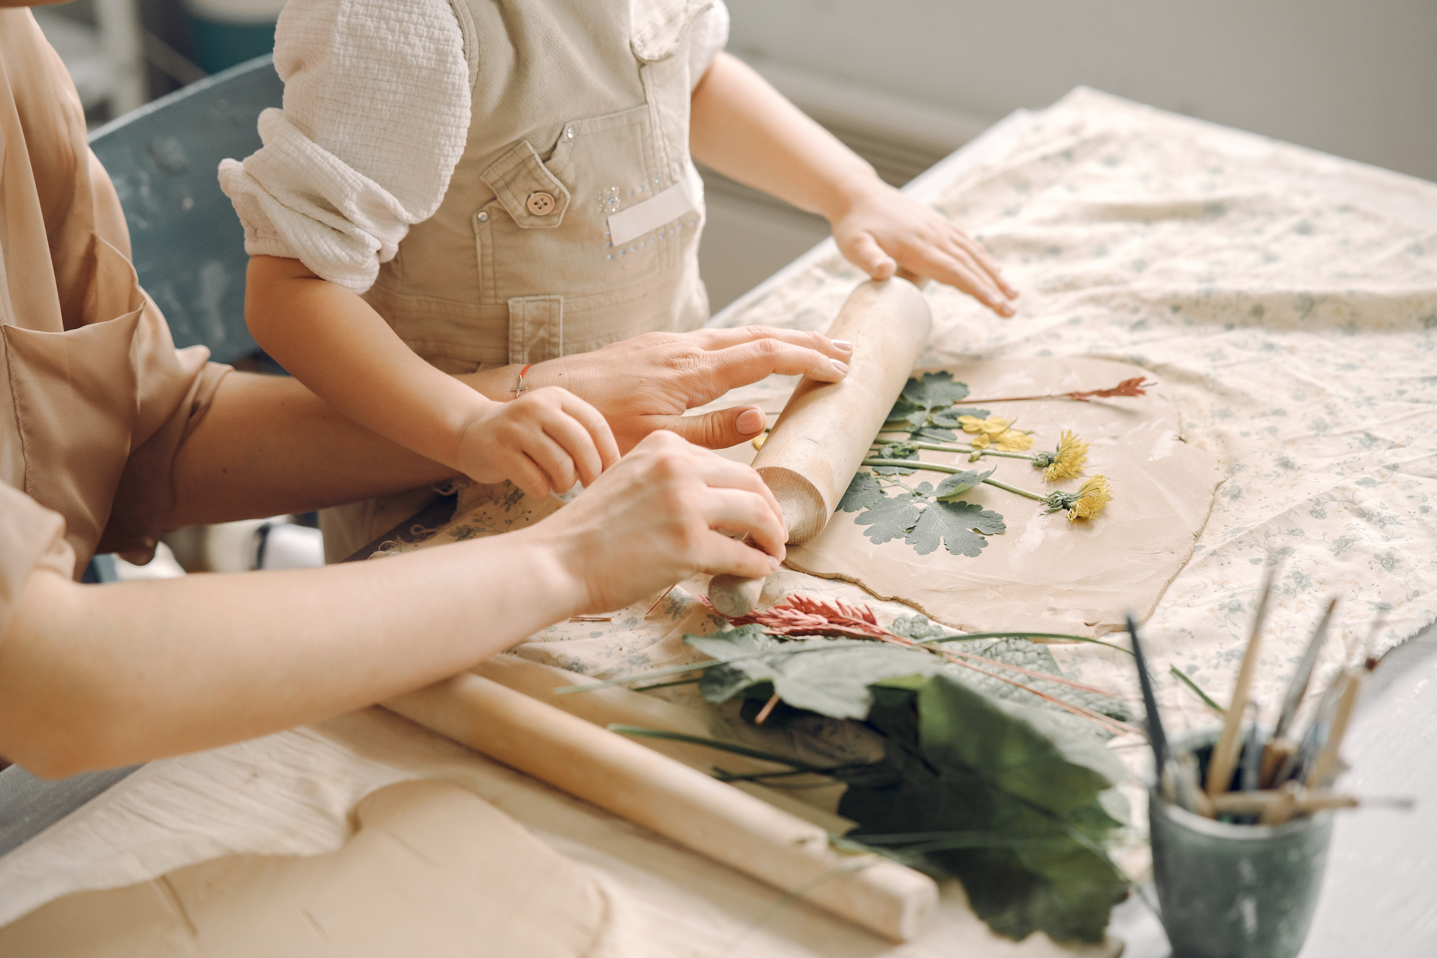
01
Business model canvas

Slide 5
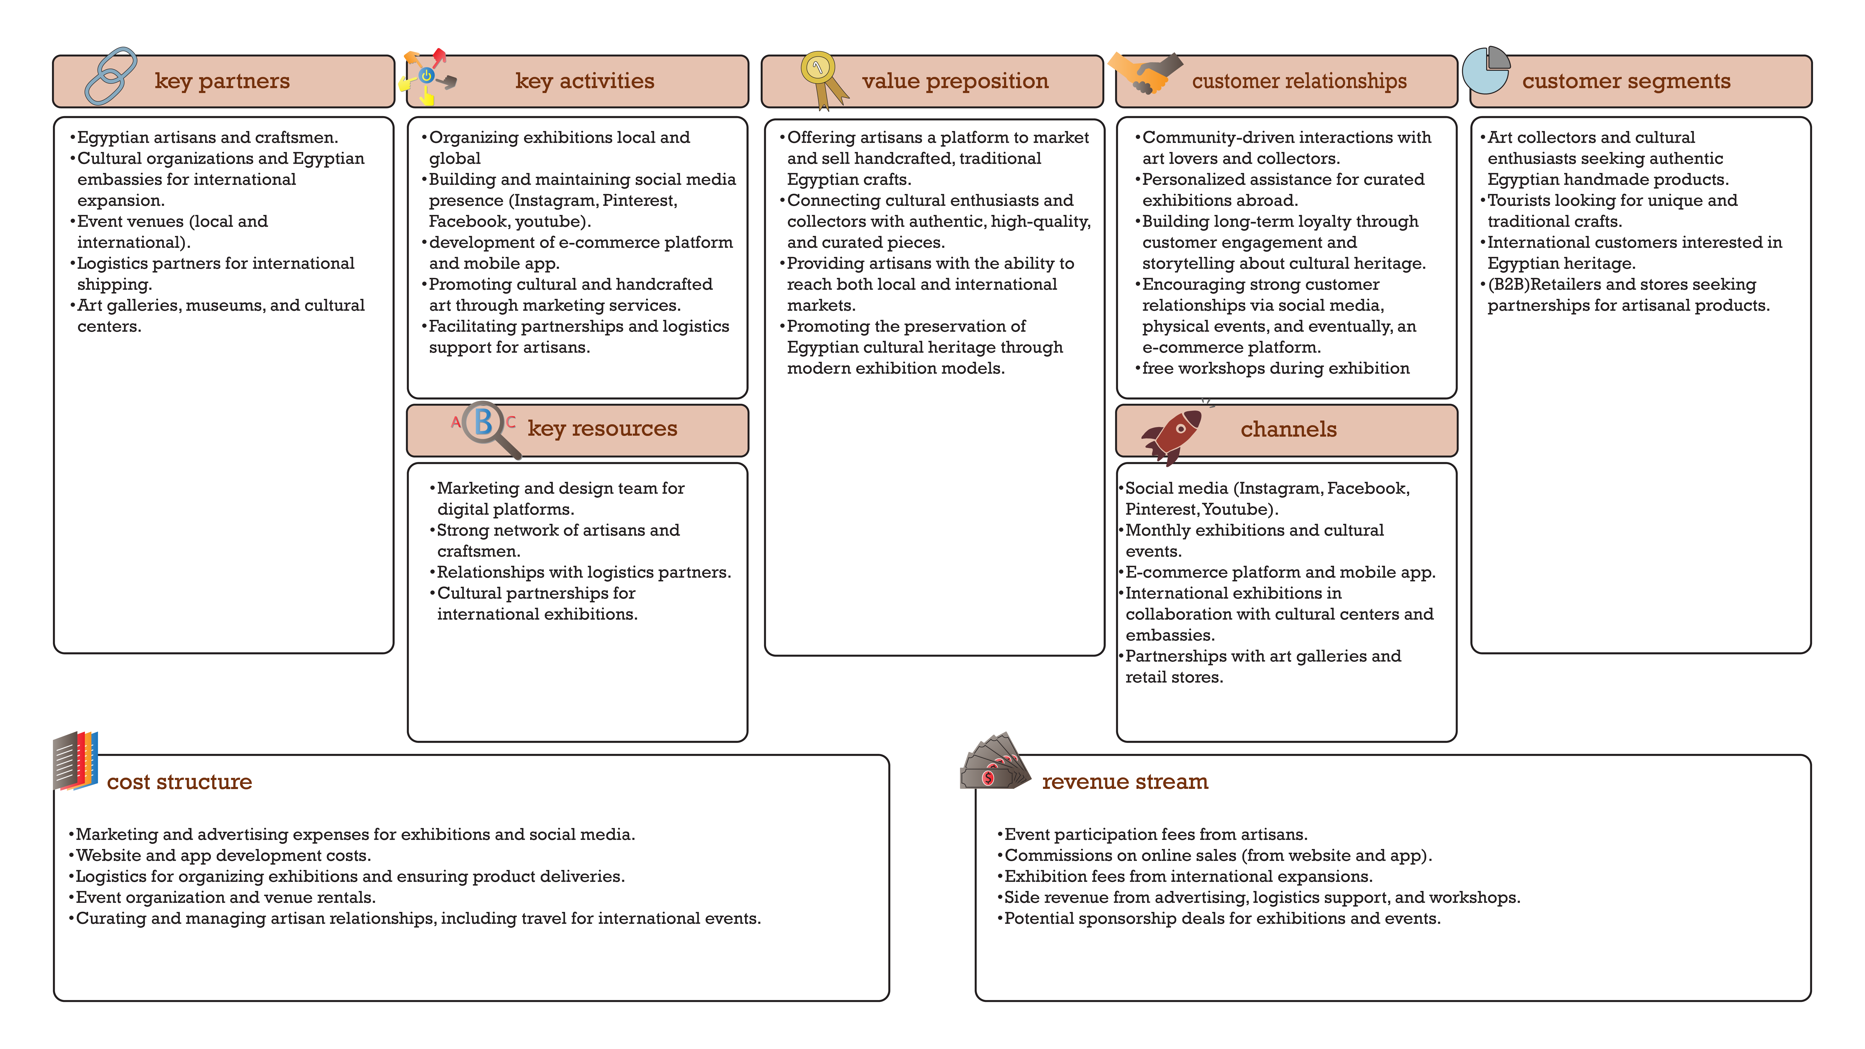

Slide 6

02
Objectives
Click Here

Slide 7
Business Objectives
Achieve a 20% increase in total sales, with total of 1,500,000 L.E
Launch our first international exhibitions by Q4 2025.
Secure a 10% annual growth in repeat customers.
Marketing Objectives
Increase brand awareness by reaching 100,000 people by Q2 2025.
Drive a 25% increase in exhibition foot traffic by January 2025.
Attain 2000 leads from online channels by mid-2025.
Achieve a 20% increase in customer engagement on social media platforms within the next six months.
Partner with at least five influencers in the arts and crafts space by the end of Q1 2025.
Digital Marketing Objectives
Increase e-commerce conversion rates by 15% within the first year.
Grow social media followers to reach 100,000 across all platforms by Q2.
Generate 1000 leads for the exhibition by September 2025.
Improve the SEO ranking to appear on the first page within six months.
Attain a 10% increase in email open rates and a 5% increase in click-through rates by Q3 2025.(considering last report)
Increase artisans to reach 70 within the next 12 months.

Slide 8
03
Market analysis
Click Here

Slide 9
SWOT
Strengths
Weaknesses
Limited brand awareness.
Resource constraints.
Pricing .
Dependence on local market.
Authenticity
Quality craftsmanship
Cultural heritage
Customization options
Strong community ties
opportunities
threats
Competition
Economic factors
Changing consumer preferences
Supply chain issues
Analysis
E-commerce growth
Sustainability trends
Collaborations
Social media marketing

Slide 10









Cairo, Egypt
Value preposition
52 k follower
It allows skilled craftsmen specialized in handicrafts and heritage industries to display artistic pieces inspired by Egyptian heritage
38.6 k follower
Handicrafts exhibition
http://turathna.eg/
It is an exhibition that allows craftsmen and artists to promote their products and encourage young people to take pride in Egypt’s heritage
services
Accessories, antiques, textiles, decorations and crafts inspired by heritage in a modern way.
300: 3000 Le
Content
Engagement
type
Frequency
Marketing the exhibition and displaying the exhibition products and offers
Reels and seminars
posts and videos
every day at morning

Slide 11

October city, Egypt
Value preposition
They support Egyptian women by promoting their handmade products. These products are distinguished by their distinctive Egyptian patterns
31 k follower
6.1 k follower
services
https://ayadymisr.com/
E-commerce Handicrafts
Fashion such as clothing, bags, and jewelry,leather crafts, Macrame, wooden crafts, metal crafts, pottery, rugs and kilim, seashells crafts
200: 3000 Le
An E-commerce for promoting, marketing and selling handicrafts and heritage products
Content
Engagement
type
Frequency
Focus on value and selling through the website, offers and discounts.
Gifts and offers
posts and reels
3 times a week

Slide 12
04
Customer persona
Click Here

Slide 13
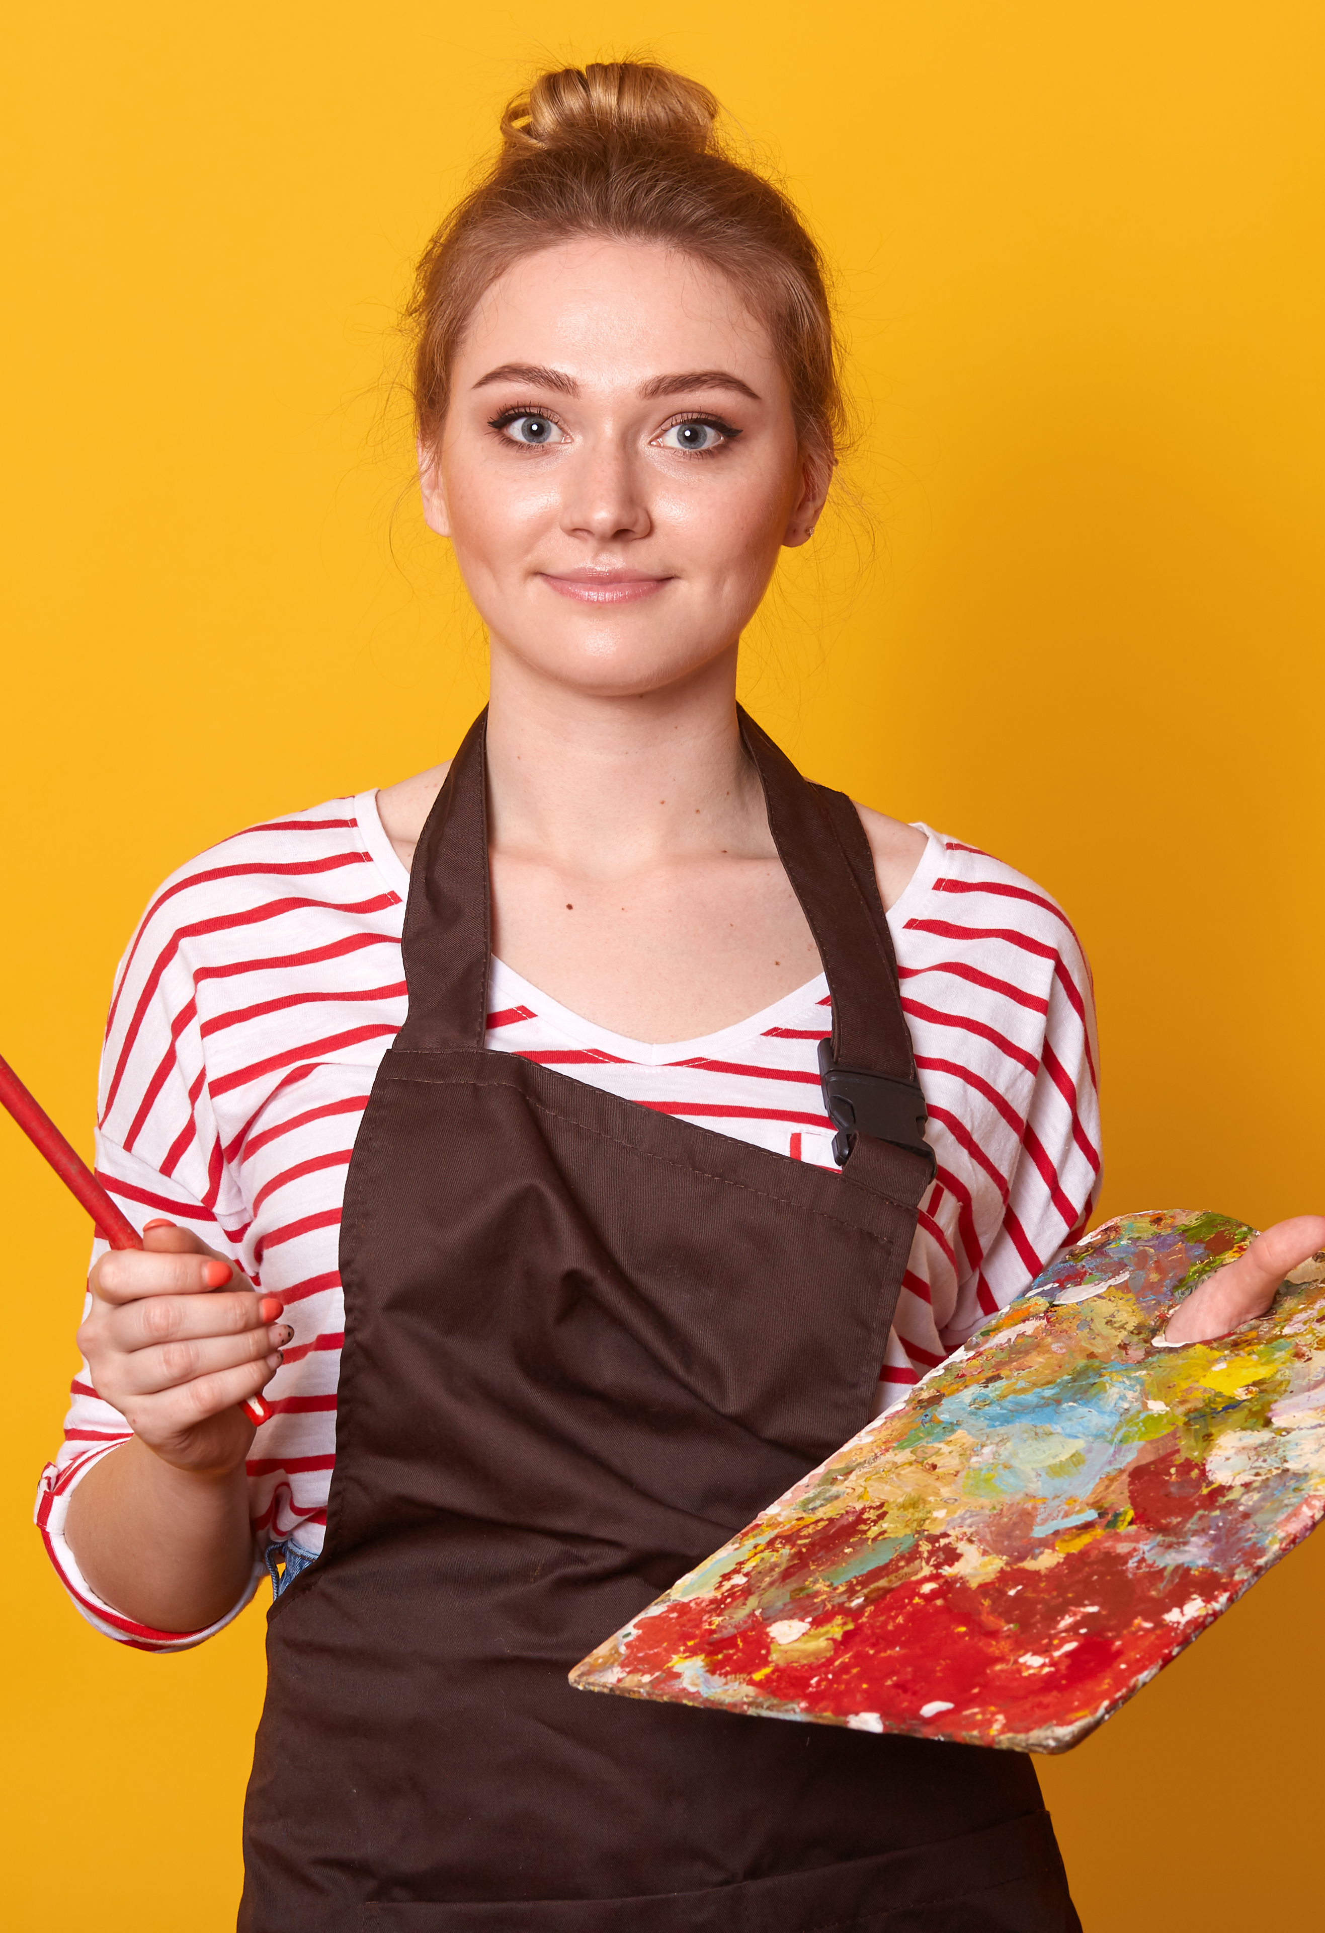
Demographics
Fashion Trends
Design
Art crafts
Graphic
Photography
Travel
cultural heritage
SARA
Interests
Creative Growth
Develop Skills
Cultural Representation
Eco-Friendly Art
Support Local Artisans
Personal Brand Development
Age: 24
Gender: Female
Location: Cairo “El Shorouk”
Education: Bachelor’s degree in Fine Arts
Status: Freelance Illustrator (Painter)
Goals
Finding Unique Resources
Budget Constraints
Market Competition
Time Management
Balancing Projects
Finding Inspiration
Limited Access to Workshops
Obstacles
Attend Local Craft Workshops
She needs to Join Artisan Collectives
She needs Networking Opportunities
She needs Inspiration for Her Work
She needs Learning Opportunities
Thoughts

Slide 14
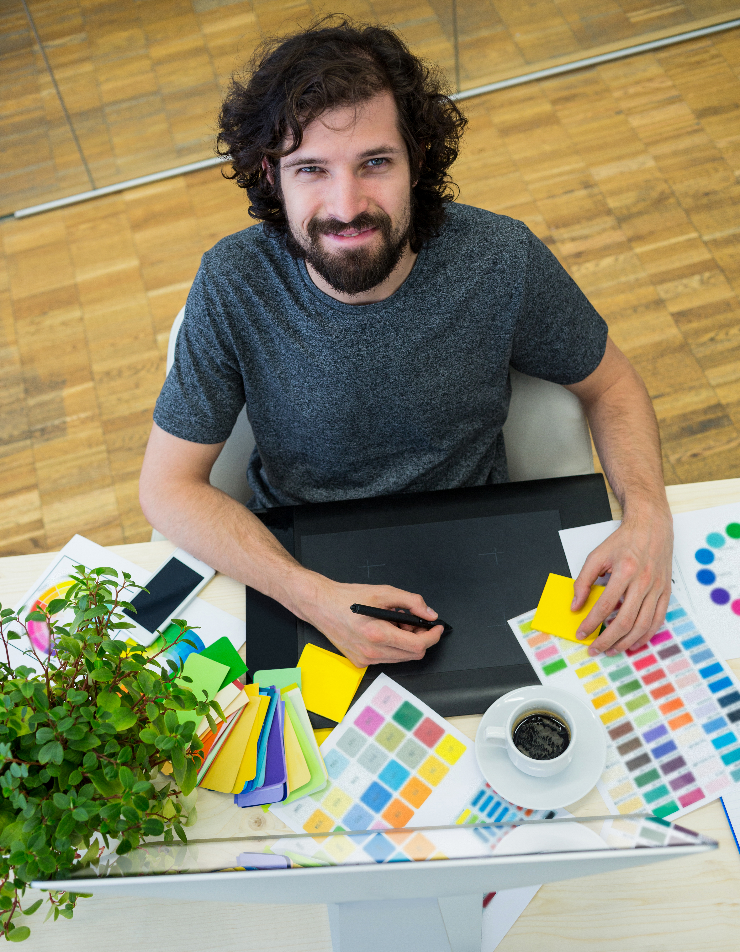
Demographics
Design
Art crafts
Graphic
Photography
Travel
cultural experiences.
local crafts
JAMES
Interests
Cultural Immersion
Artistic Inspiration
Documenting Cultural Practices
Promoting Cultural Exchange
Reducing Environmental Impact
Goals
Age: 34
Gender: male
Nationality: American
Location: Cairo, Egypt Education: Master’s degree in Fine Arts
Status: Freelance Graphic Designer
Language Barrier
Cultural Sensitivity
Finding Authenticity
Finding Resources
Finding Relevant Events
Balancing Work and Exploration
Obstacles
Expanding His Expat Community
He need Inspiration and Learning
Need Cultural Orientation Workshops
Collaboration with Local Artists:
Thoughts

Slide 15
05
Channels

Slide 16





Channels
FACEBOOK`
WEBSITE
YOUTUBE
MOBILE APP
INSTAGRAM
E-MAIL
PINTEREST

Slide 17
06
Brand voice

Slide 18
Brand voice
Creative & Inspirational:
Friendly.
Authentic & Proud

Slide 19
07
Content calendar
Click Here

Slide 20
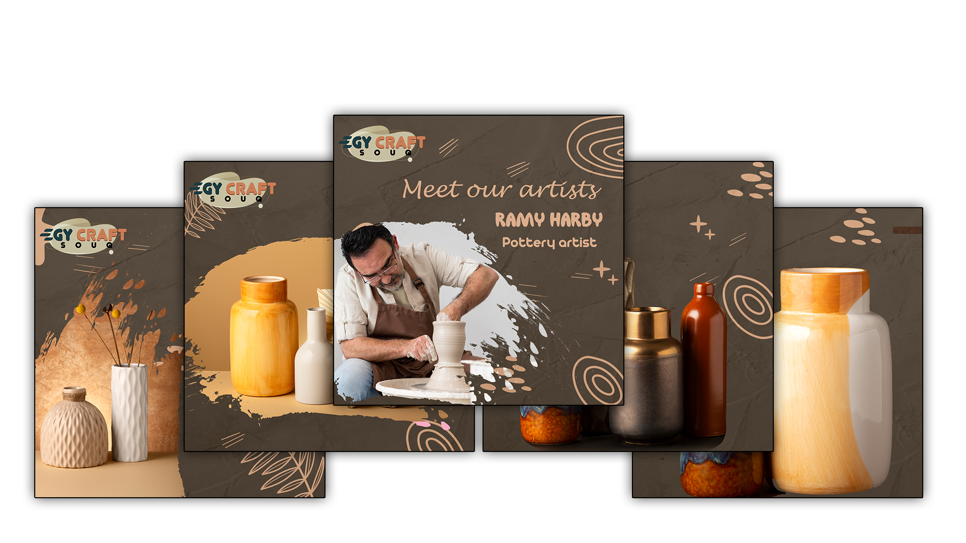
"Creativity is the key to unlocking your true potential"

Slide 21
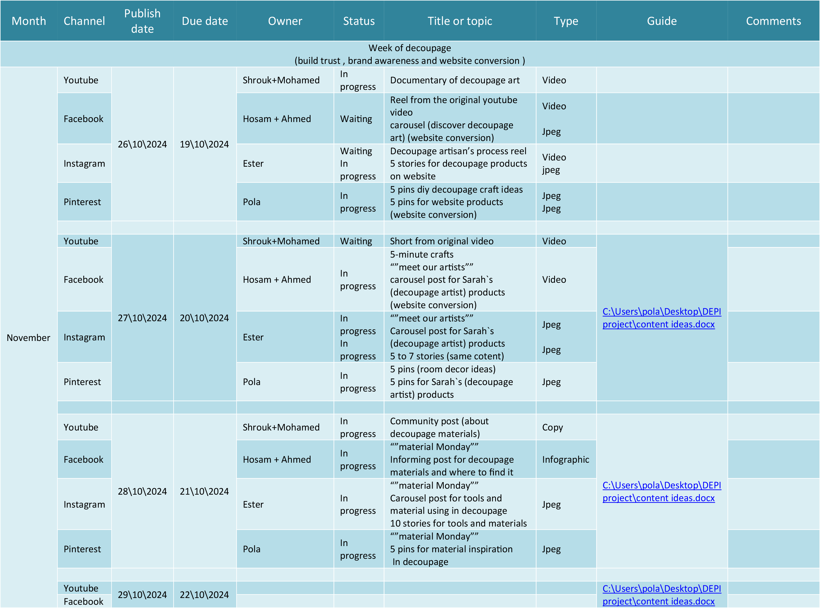

Slide 22
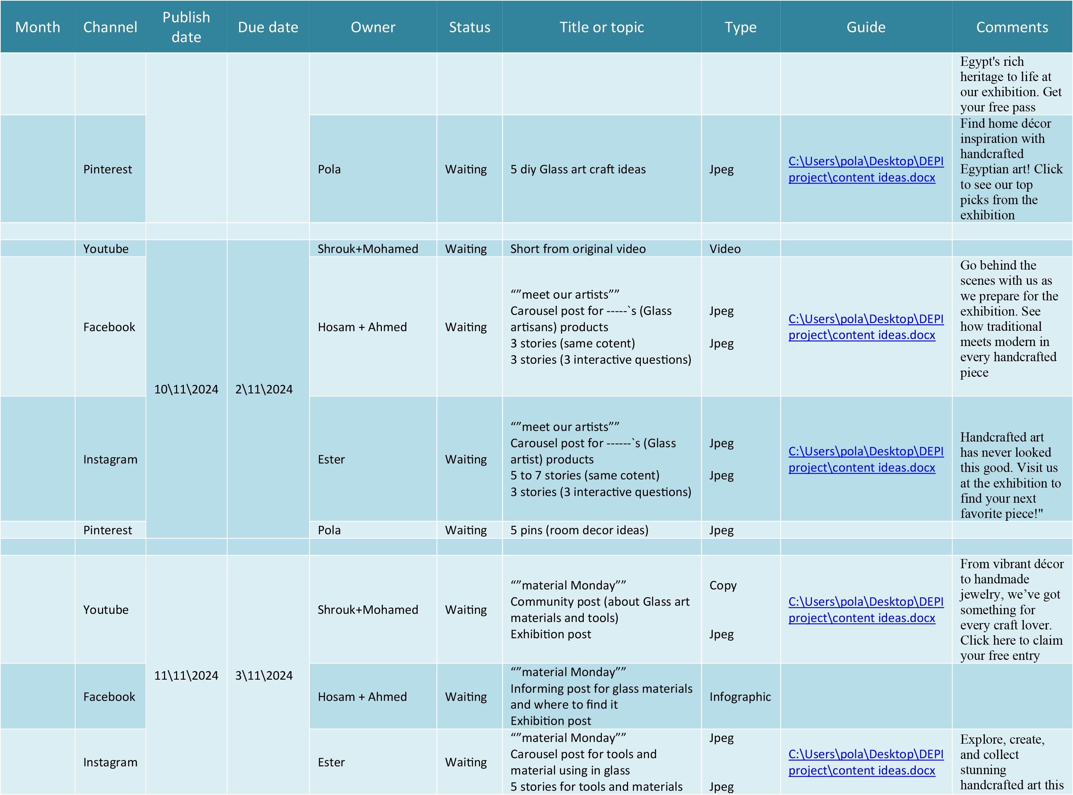

Slide 23
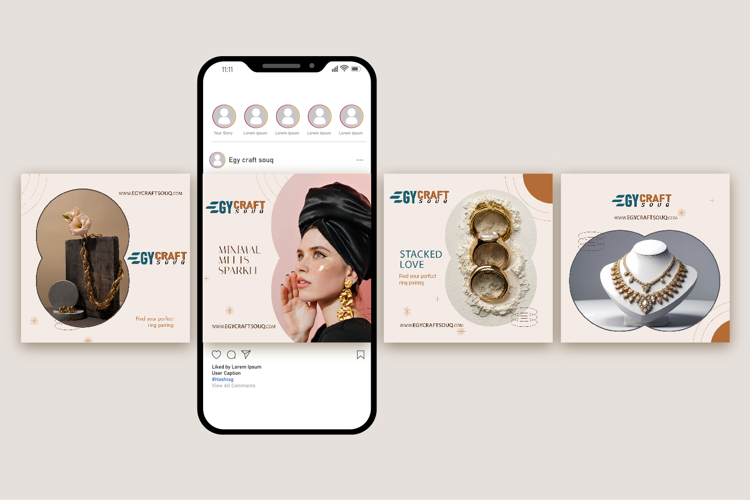
Keywords

Slide 24
08
E-mail marketing
Click Here

Slide 25
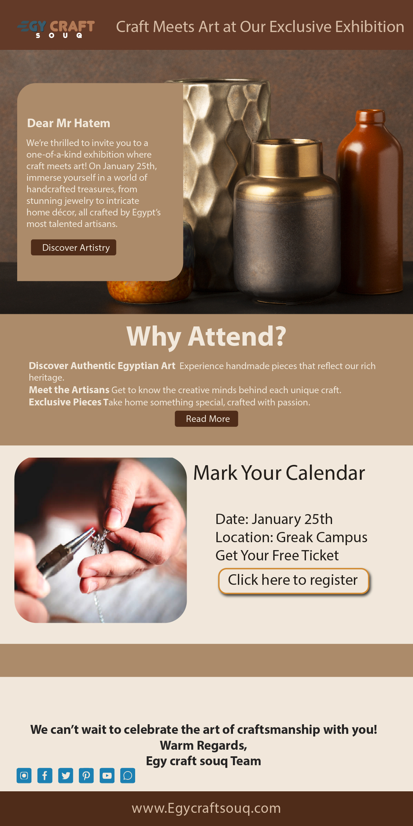
E-mail marketing
Subject line
Mark Your Calendars – Craft Meets Art at Our Exclusive Exhibition

Slide 26
09
Keywords research
Click Here

Slide 27

Search volume
246,000
Search volume
14,800
High range
2.63$
Low range
0.37$
High range
6.07$
Low range
1.07$
Gift
handicraft
Key word research
High
Low
Search volume
5,400
Search volume
3,600
High range
1.91$
Low range
0.34$
High range
2.96$
Low range
0.30$
Hand craft gift
Handcraft shop
High
High

Slide 28
10
Website
Click Here

Slide 29
11
Ads
Click Here

Slide 30

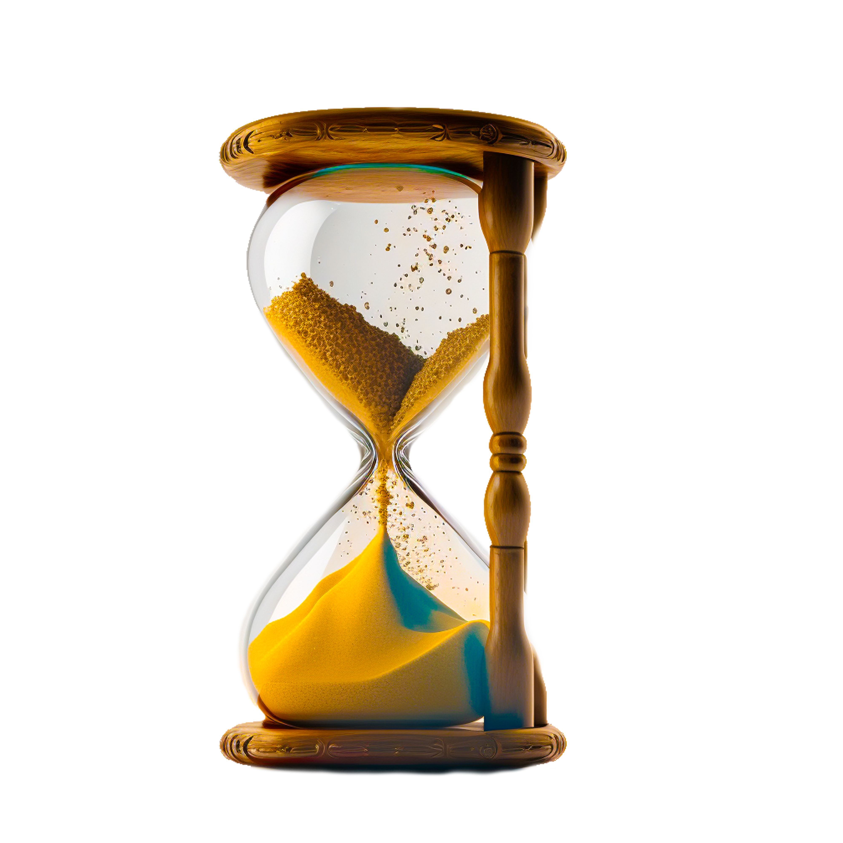
Facebook ads for first 3 months
60,000
Conversion
Engagement
Page like
message
Test
Ad
7 days 83 days 90 days 90 days 7 days 83 days
2500 L.E 12500 5000 12500 2500 30000
80k – 100k 6k – 8k 2k – 2.5k

Slide 31
Instagram ads for first 3 months
30,000
Awareness
Visit profile
conversion
Test
Ad
90 days 7 days 83 days 7 days 83 days
7500 L.E 2500 15000 2500 7500
80k – 130k 10.5k – 7.5k 100k – 150k

Slide 32
12
Budget
Click Here

Slide 33

Budget
Duration
Ad type
Objectives
30,000
60,000
30,000
3 months
6 months
1 month
Reels
Photos
Video
Reels
Photos
Video
Reach(80k-130k)
Visit profile (10500 -7500).
Engagement (100k – 150k)
Conversions
Conversions
Page like (13k- 20k)
Engagement (160k – 200k)
Messages (1250 – 1500)
Reach (100k- 150k)
Leads
Visit (6000 – 5000)
Conversions (15000 - 10000k)

Slide 34
Budget
Keywords
Objectives
4.2*500 =2100
1.125*1000=1125
46*500 =23.000
23*1000 =23.000
handicraft
hand craft gift
الحرف اليدوية
معارض للحرف اليدوية في مصر
Organic traffic
Improve search engine ranking for targeted keywords to drive long term sales.
Budget
Duration
Objectives
Website
developing
10,000
120,000
Convert web site visitors.
Sales
Increase in exhibition foot traffic.
Increase sales.
3 months
Two exhibitions every year for 2 days.
Budget
Duration
Objectives
Exhibition
cost
Total 300,000

Slide 35
13
KPIs
Click Here

Slide 36
Reach and impression.
Engagement rate.
Conversion rate.
Click -through rate (CTR).
Traffic and Page views
engagement
Conversion
click -through rate (CTR)
cost per click (CPC)
conversion rate
impression
EMAIL Open rate
Email Click through rate

Slide 37
Thanks for your time

